Slide 1
State Performance Plan Indicator 14
Simple Solution. Brighter Futures.
September 2019

Slide 2
Texas Student Data System - TSDS
TSDS is Student Data!
Notes:
Analogy of TSDS

Slide 3
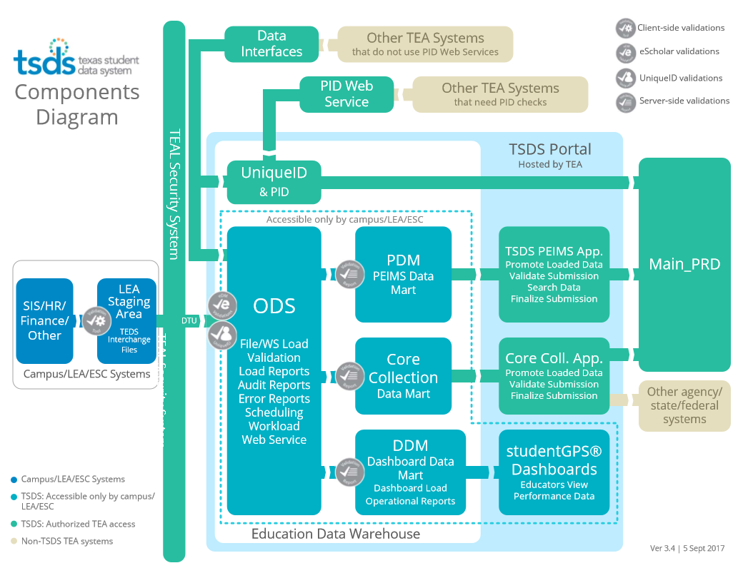
TSDS Explained
Notes:
Technical data loading staff at the LEA will extract the data for the SIS and load it via eDM for all collections, validate the data, and then verify that the data loaded into the ODS.
The Special Program Staff will then promote the data which will pull the data from the ODS into the applicable Data Mart where the submission will be validated, reports checked, and completed.

Slide 4
SPPI-14 in TSDS for 2019-2020
TSDS Demo for SPPI-14
Helpful Resources

Slide 5
SPPI-14 Collection Timeline
The SPPI-14 collection will remain open in TSDS until February 20, 2020 (the third Thursday in February).
Third Thursday in February
Notes:
Here is our timeline for SPPI-14

Slide 6
Data Collected for SPPI-14
PEIMS Data from Prior Year PEIMS Summer
(The promotion will automatically retrieve this data.)
Student Basic Demographics
Latest Effective Date (SPED)
Instructional Setting Code
Primary Disability Code
TSDS Collection
Education Organization Interchange
Student Parent Interchange – Student and Parent Contact Information
PEIMS Fall Submission
Education Organization Interchange
Student Extension Interchange – Student Demographics
Student Enrollment Interchange – Leaver Information with Military Enlistment Data
SPPI-14
Notes:
From PY PEIMS Summer For 2019-20 the Primary Disability Code will be retrieved from the discipline and/or restraint event data as reported in the 2018-19 PEIMS Summer submission. The latest disciplinary incident or restraint event will be used. If the student does not have a disciplinary incident or restraint event the primary disability code will be blank.
Also for 2019-20, the Instructional Setting Code will be retrieved from Special Education Attendance using the max attendance reporting period on 2018-19 PEIMS Summer submission.
Beginning in 2020-21 this data will be retrieved from the Special Education Program complex type on the prior year PEIMS Summer submission. SPED Pgm complex type added to PEIMS Summer.

Slide 7
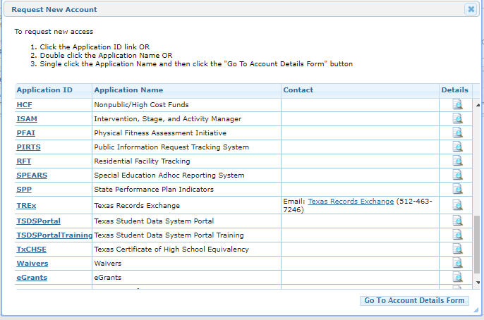
Request access to TSDS
Login to your TEAL account and request access to the TSDS Portal and then request the appropriate Core roles for SPPI-14.
Notes:
You will need to request access to the TSDS Portal and then request the TEAL roles you will need for the submission. When you request these roles you will need to request them for one of your LEA and obtain files from that LEA to load into the system.

Slide 8
Lea TEAL Roles for SPPI-14
TEAL Roles for Special Ed Program Staff at the LEA who will promote, validate, and complete the SPPI-14 submission:
Core LEA Data Viewer
This role can monitor data promotions and data validations and generate reports.
Core LEA Data Promoter
This role initiates the promotion which will move the data from the ODS. This role can schedule and monitor promotions, schedule and monitor validations, and generate reports.
Core Data Completer
This role formally certifies the completeness and accuracy of the data and submits it to TEA. In addition this role can also schedule and monitor promotions, schedule and monitor validations, and generate reports.
Core Data Approver
This role is generally for the Superintendent or his/her designee at the LEA. The role will allow the LEA to request an extension for the SPPI-14 submission in extreme situations.
The role the LEA Special Ed staff would request will depend on the individual’s level of responsibility at the LEA.
Notes:
In order for you to submit the SPPI-14 submission, you can begin requesting Core roles for SPPI-14.

Slide 9
ESC TEAL Roles for SPPI-14
TEAL Role for Special Ed Program Staff at the ESC
Core ESC Data Viewer
This role will allow the ESCs to monitor promotions and validations for their LEAs and view reports.
Notes:
Continued…

Slide 10
SPPI-14 in TSDS for 2019-2020
TSDS Demo for SPPI-14
Helpful Resources

Slide 11
Example of SIS extract

Slide 12
SIS to EDM
Notes:
The files obtained from the SIS

Slide 13
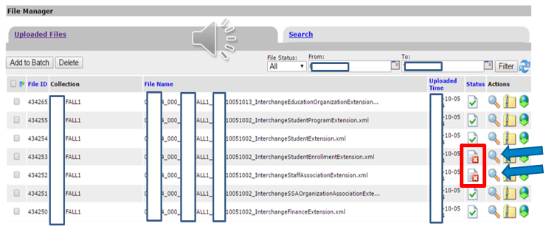
EDM File Manager and Batch Manager

Slide 14
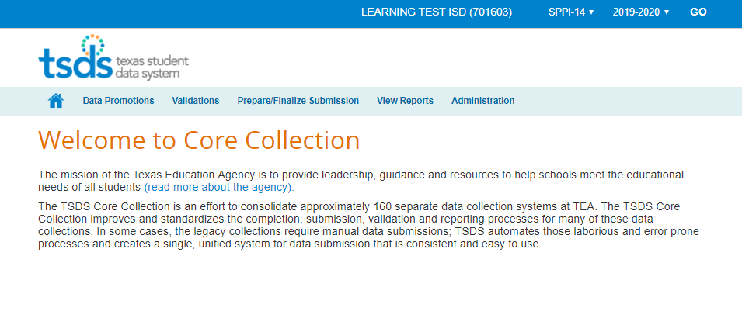
TSDS SPPI-14
Notes:
When promoting and validating for SPPI-14 it is best at this time to promote/validate all categories and subcategories.

Slide 15
DATA PROMOTION
To Promote the SPPI-14 submission data, hover over Data Promotions.
Click on Promote Loaded Data.
SPPI-14
2019-20
1
The Promote process will pull PEIMS data and TSDS data from the ODS and the prior year PEIMS data from the staging tables to the Core Collection Data Mart.
Notes:
Promote – pulls the Summer PEIMS data and the TSDS data into CCDM from the ODS.

Slide 16
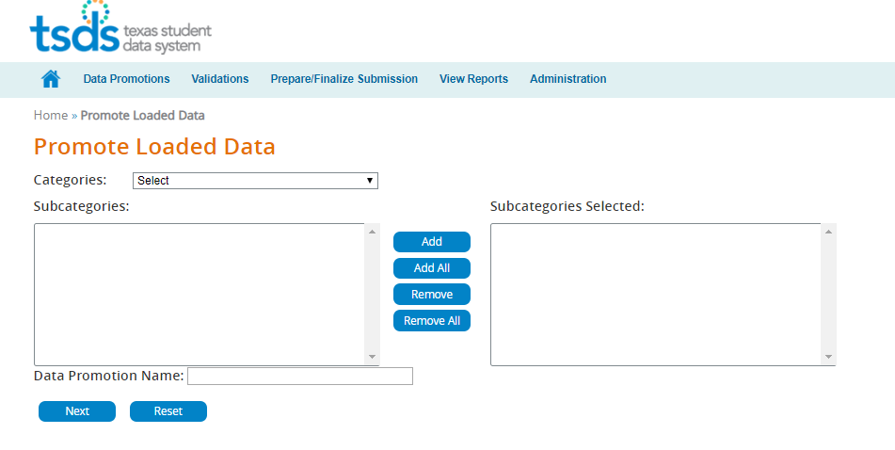
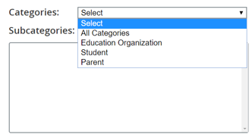
PROMOTE ALL CATEGORIES
For SPPI-14 you should always select All Categories.
Click Next.
SPPI-14
2019-20
The Promote process will pull PEIMS data and TSDS data from the ODS and the prior year PEIMS data from the staging tables to the Core Collection Data Mart.
Notes:
There is an option to select individual categories BUT for SPPI-14 you should always promote All Categories.

Slide 17
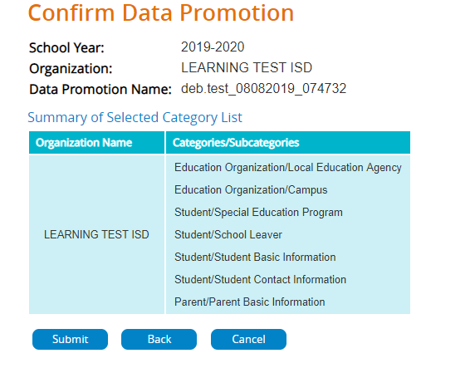
CONFIRM DATA PROMOTION
The confirmation screen will show the categories and subcategories that will be promoting.
Confirm that this is correct. Then click Submit.
Notes:
Upon submittal the data moves to what is called the ODS (Operational Data Store).

Slide 18
MONITOR DATA PROMOTION
The Home button will bring you back to the Core Collection home page.
Hover over Data Promotions. Click on Monitor Data Promotions.
SPPI-14
2019-20

Slide 19
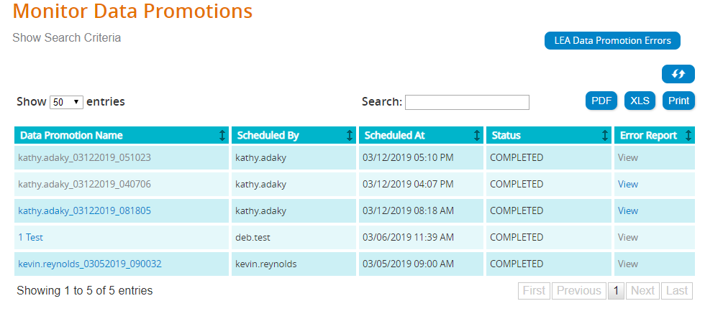
PROMOTION DETAILS AND STATUS
The Monitor Promotions screen will show each data promotion job for this submission.
The Status column will indicate Failed, Completed, Completed with Errors, or In Progress for each promotion.
Test_SPPI_04122019 Tester
Test_SPPI_04022019 Tester
Completed with Errors
Test_SPPI_04012019 Tester
Test_SPPI_03262019 Tester
Test_SPPI_03212019 Tester
Notes:
The Data Promotion Name, Scheduled by, Scheduled at, Status, and Error Report columns.
Sort functions.

Slide 20
VIEWING PROMOTION DETAILS
Click on the Data Promotion Name to view the details for this promotion.
Click on View in the Error Report column to view all errors for this promotion.
Click on LEA Data Promotion Errors to see errors for all promotion jobs for this submission.
Test_SPPI_04122019 Tester
Test_SPPI_04122019 Tester
Completed with Errors
Test_SPPI_04122019 Tester
Test_SPPI_03262019 Tester
Test_SPPI_04122019 Tester
Notes:
Click on View in the Error Report column to view all errors for this promotion.

Slide 21
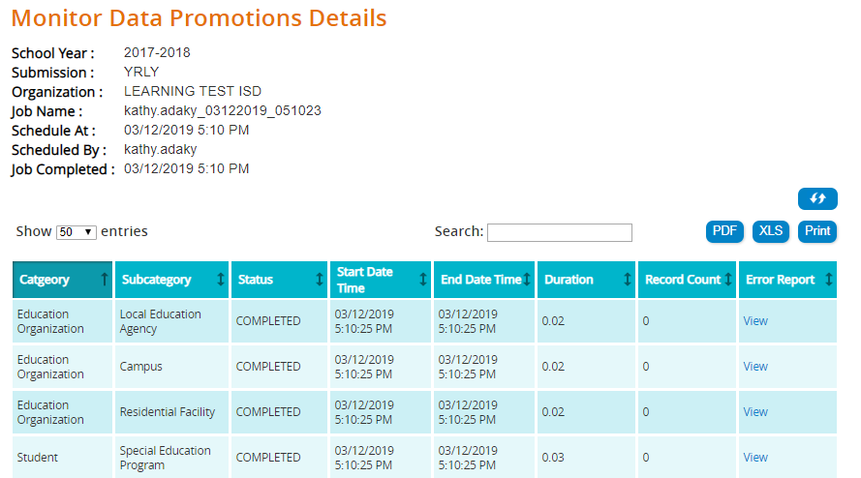
DATA PROMOTION DETAILS
Click on the Data Validation Name to view the details for this promotion.
Next, you will see the details for each promoted Category and Subcategory.
Click View in the Error Report column to see the errors. Reach out to your LEA Technical Data Loader or SIS Vendor if you need assistance resolving the errors.
Test_SPPI_04022019
Tester
Test_SPPI_04022019
Tester
Completed with Errors
2019-2020

Slide 22
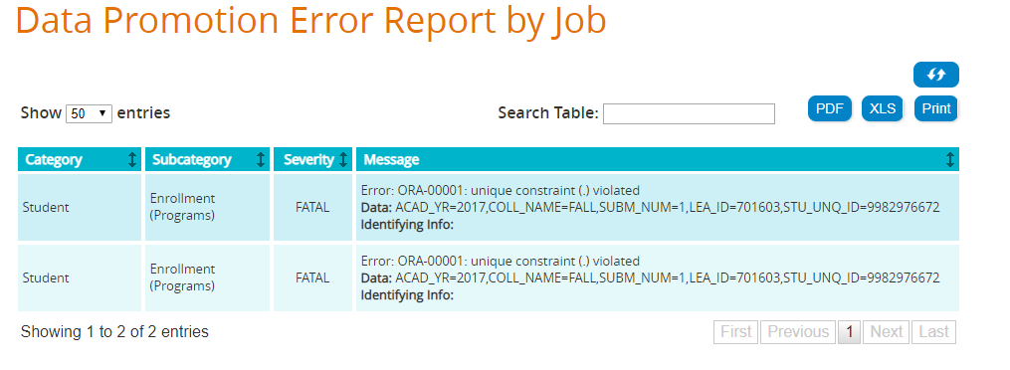
VIEWING A DATA PROMOTION ERROR
Texas Education Data Standards (TEDS) specifies certain Unique Constraint elements which dictate that the combination of specific elements can only be in the file one time.
In this error message, you see “Unique Constraint” and can see that the Data in both errors is exactly the same.
Your Technical Data Loader or SIS Vendor would need to determine why these elements appear two times on the extract from the SIS.
Next, resolve the errors in the SIS. The TSDS Technical Data Loader will then extract and upload the corrected files. Then you can Promote to the Core Collection Data Mart and view the Promotion status and errors again.
Notes:
Each time errors are found they must be resolved in the SIS and the whole process begins again. (Slide 11)
(1) TSDS Data Loader extracts from the SIS.
(2) TSDS Data Loader loads the newly extracted XML files into the eDM and verifies the ODS was updated.
(3) Next, staff will promote the data to the CCDM, check the errors, validate the data, check errors, and finally complete the submission.

Slide 23
VALIDATIONS
Hover over Validations. Click on Validate Submission Data.
The Validation screen is very similar to the Promotion screen.
You will be able to choose the type errors you wish to Validate. (Fatal, Special Warning, Warning)
Enter Data Validation Name. Click Next.
2
Notes:
Business Rules are executed

Slide 24
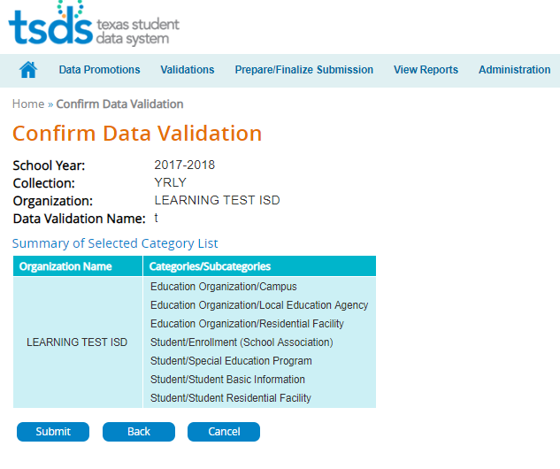
CONFIRM DATA VALIDATION
Next, you will confirm this is the data you wish to Validate.
Click Submit.
2019-2020
(Student Programs)
Notes:
Upon Submittal the files will go through Business Rules Validation

Slide 25
MONITOR DATA VALIDATIONS
Hover over Validations. Click on Monitor Data Validations.
Just as with the Monitor Data Promotions, this will allow you to see your errors.
2

Slide 26
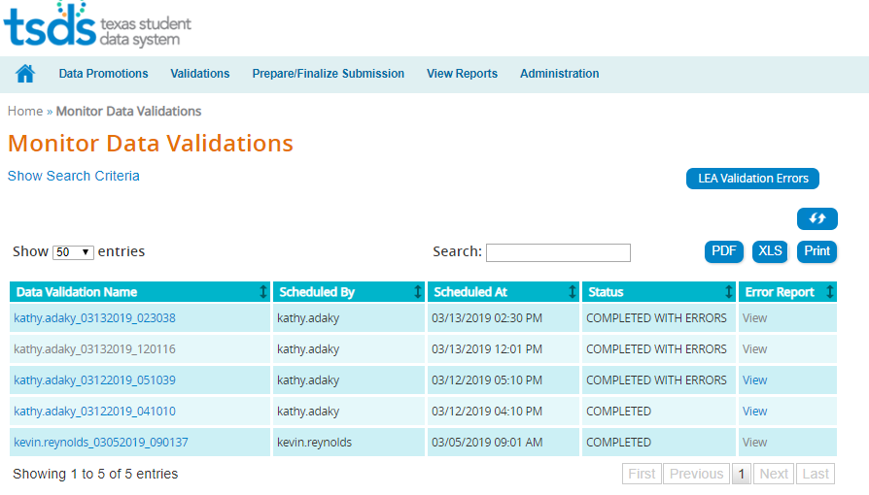
MONITOR DATA VALIDATIONS
The Monitor Validations screen will show all data validation jobs for this submission.
The Status column will indicate Completed, Completed with Errors, or In Progress for each validation job.
Test_SPPI_04122019 Tester
Test_SPPI_04112019 Tester
Test_SPPI_04102019 Tester
Test_SPPI_04052019 Tester
Test_SPPI_04012019 Tester
Notes:
The Data Promotion Name, Scheduled by, Scheduled at, Status, and Error Report columns.
Sort functions.

Slide 27
VIEWING VALIDATION DETAILS
Click on the Data Validation Name to view the details by Category and Subcategory for this validation job.
Click on View in the Error Report column to view all errors for the validation job.
Click on LEA Validation Errors to see errors for all validation jobs for this submission.
Test_SPPI_04122019 Tester
Test_SPPI_04122019 Tester
Test_SPPI_04122019 Tester
Test_SPPI_04122019 Tester
Test_SPPI_04122019 Tester

Slide 28
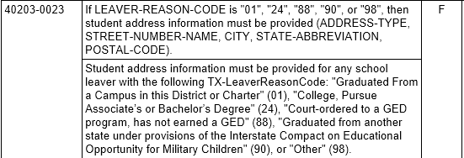
VALIDATION ERRORS
Evaluate the errors and determine what action should be taken to correct the error.
Errors must be corrected in the local Student Information System (SIS). Then the LEA Technical Data Loader will extract the corrected XML interchanges and load them into the ODS.
SPED program area staff will promote and validate again.
Many times clearing up one error will also resolve other related errors.
Notes:
Evaluate these errors and discuss resolution steps.

Slide 29
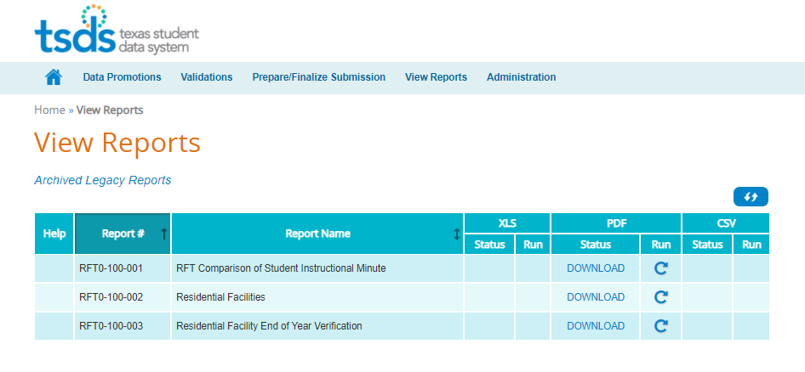
RUN THE SPPI-14 REPORT
Click on View Reports to run the SPPI-14 report and verify the data before you complete the submission.
Click the Run icon to generate the report.
3
SPPI-100-001
TSDS SPPI-14 Student Roster Report
Notes:
Click on the Run icon to generate report.
Start early validating and reviewing the report. Might consider running report by campus and ask the campus SPED staff to verify.

Slide 30
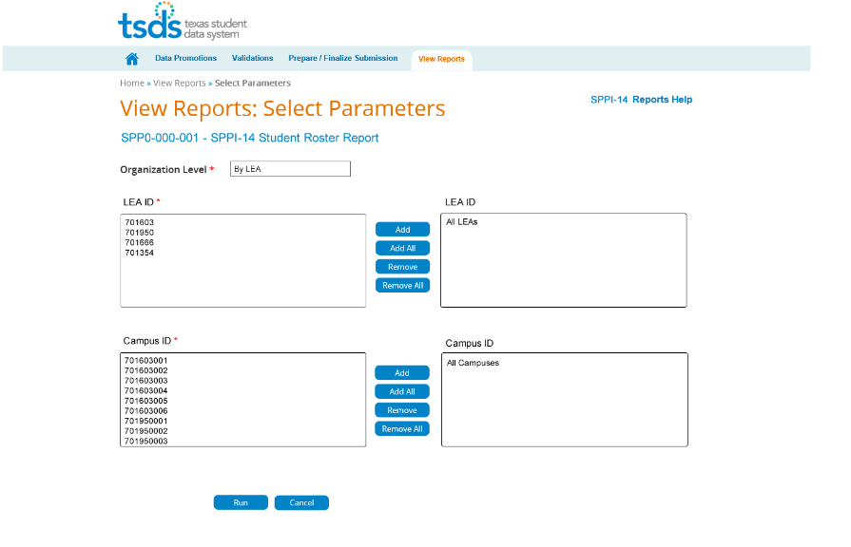
REPORT PARAMETERS
You will be redirected to the parameter screen after clicking the run icon.
You can run the report for the LEA, for all campuses or for individual campuses for which you have access. Click Run after parameters are set.
Notes:
Run for entire LEA or by campus

Slide 31
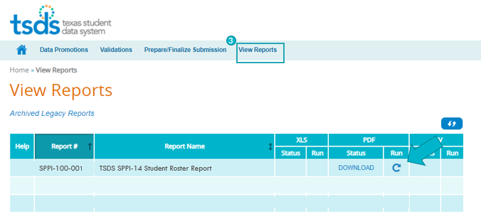
RUN THE SPPI-14 REPORT
After you set the parameters, clicked Run and you will be taken back to this screen.
Download in the status column indicates the report is ready.
Click Download to view the report.
Notes:
The Status will show “In Progress” while the report is being generated.
“Download” will indicate the report is ready. Click Download to view the report.

Slide 32
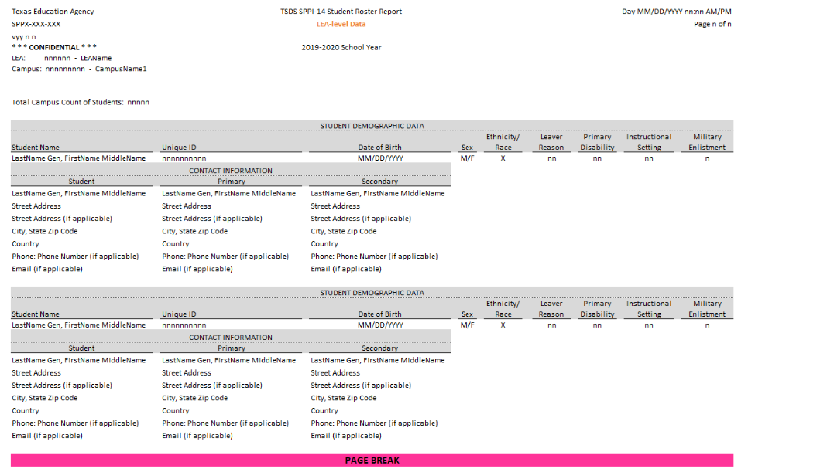
SPPI-100-001
TSDS SPPI-14 Student Roster
Notes:
Be sure all students who should have one of the five leaver codes (01, 24, 88, 90, or 98) are listed on the report.
01 – Graduated
24 – Entered college and is working towards an Associate’s or Bachelor’s degree
88 – Court ordered to GED program, has not earned a GED
90 – Graduated from another state under provisions of the Interstate Compact on Educational opportunity for Military Children
98 – Other (dropped out)
Contact priority code will determine which parent is listed as the Primary and which is the Secondary.
Reporting address – Priority (1) Mailing, (2) Home, (3) Physical
Telephone – Priority (1) Home, (2) Mobile, (3) Work, (4) Emergency 1, (5) Emergency 2, (6) Unlisted
Email – Priority (1) Home/Personal, (2) Work, (3) Organization

Slide 33
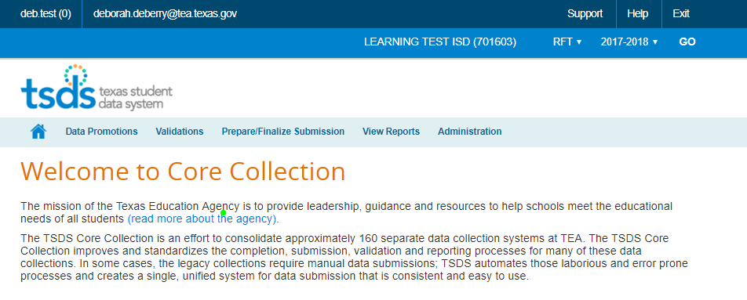
ADMINISTRATION TAB
The Superintendent of the LEA or his/her designee can request an extension if there are extenuating circumstances.
The request should be submitted prior to completing the data.
The Administration tab will only be available to the Superintendent or designee who has the Core Data Approver role.
SPPI-14
2019-20

Slide 34
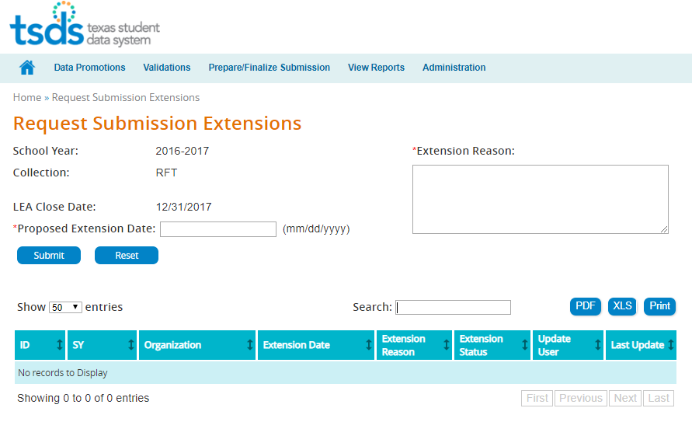
REQUEST AN EXTENSION
The Superintendent of the LEA will enter the Proposed Extension Date and Extension Reason. Then click Submit.
Extension requests will be reviewed by TEA and approved or denied. An email will be sent to the Superintendent stating the outcome of the request and the extended Collection due date.
The due date is not extended until TEA notifies the Superintendent of the extended due date.

Slide 35
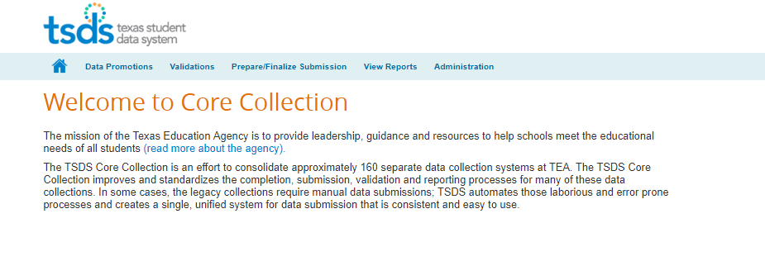
FINALIZE THE SUBMISSION
Core Data Completer will finalize the SPPI-14 Collection only when:
The Collection is Fatal free,
All Special Warnings and Warnings have been verified, and
All Reports have been reviewed for completeness and accuracy.
From the Home Page, click Prepare/Finalize Submission.

Slide 36
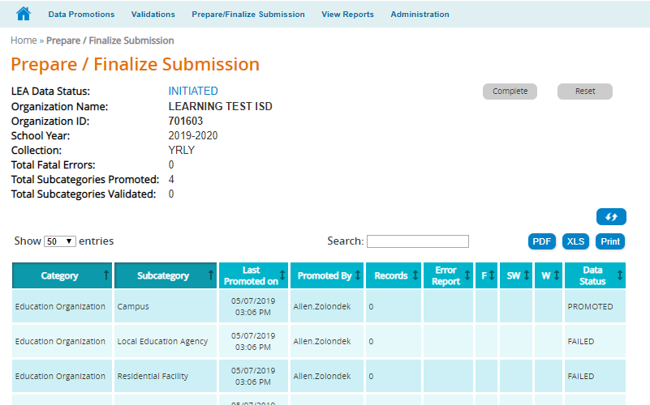
FINALIZE THE SUBMISSION
On the Prepare/Finalize screen
You will see a summary of the Categories and Subcategories you have Promoted and Validated.
You will also see the error counts for the Collection. (If you have any Fatals, you will not be able to Complete the submission.)
Continue working through all errors until each has been resolved or verified and the report has been reviewed.
2019-2020
10

Slide 37
MARK THE SUBMISSION COMPLETE
When Fatal free, click the Complete button, read the acknowledgement, and check the box. Click Confirm.
Once confirmed, the SPPI-14 submission is marked final and officially submitted to TEA.
Notes:
Once errors are resolved and the reports are reviewed, click on “Complete”, check box, and click “Confirm”.

Slide 38
RESET THE SUBMISSION
The Reset button will allow you to recall you submission and continue to make corrections to the data.
You can reset your submission as often as needed until TEA’s submission due date.

Slide 39
Submission reset
6. Click ‘Complete’ to submit submission
1. Click ‘Reset’
5. Rerun reports
2. Reload data into ODS
4. Rerun validations
3. Re-promote data

Slide 40
COMPLETE THE SUBMISSION
If you reset your submission,
Make corrections in your SIS,
Technical data loader will extract and reload corrected data into ODS,
Promote and validate the data again,
Verify that data is fatal free and review all reports,
Click the Complete button,
Read the acknowledgement, check the box, click Confirm.
The SPPI-14 submission is marked final and officially submitted to TEA.

Slide 41
SPPI-14 in TSDS for 2019-2020
TSDS Demo for SPPI-14
Helpful Resources

Slide 42
Level 2 TSDS Incident Management System (TIMS) Role
ESC Special Education staff should request the TIMS Level 2 Support role in order to review, resolve, or escalate TIMS tickets submitted by the LEA Special Education staff.
TEA envisions that the Special Education staff at the ESC will review and resolve tickets pertaining to RFT and/or SPPI-14 since they understand the terminology and guidelines for these TSDS submissions.
The first step to becoming an ESC TIMS Champion is to be nominated by your Executive Director and then attend the TIMS certification training on October 15, 2019, at 9 am here at TEA.
Notes:
Please work with the current TIMS Champions at your ESC prior to the October training.

Slide 43
SPPI-14 Technical Resources
TEA Website and Communication Resources
TAA Letter – May 2, 2019
Texas Education Data Standards Resources
Texas Education Data Standards (TEDS)
Delete Utility Reload Guide (DURG) for TSDS Deletes
Support Resources
KB Articles
TSDSKB-585 – General FAQs for SPPI-14
Email Special Education Division at TEA
Email TSDS Customer Support
Notes:
The DURG will be updated to include new tables that are being added to some of the Deletes.
Consider showing navigating to KB article if time allows.

Slide 44
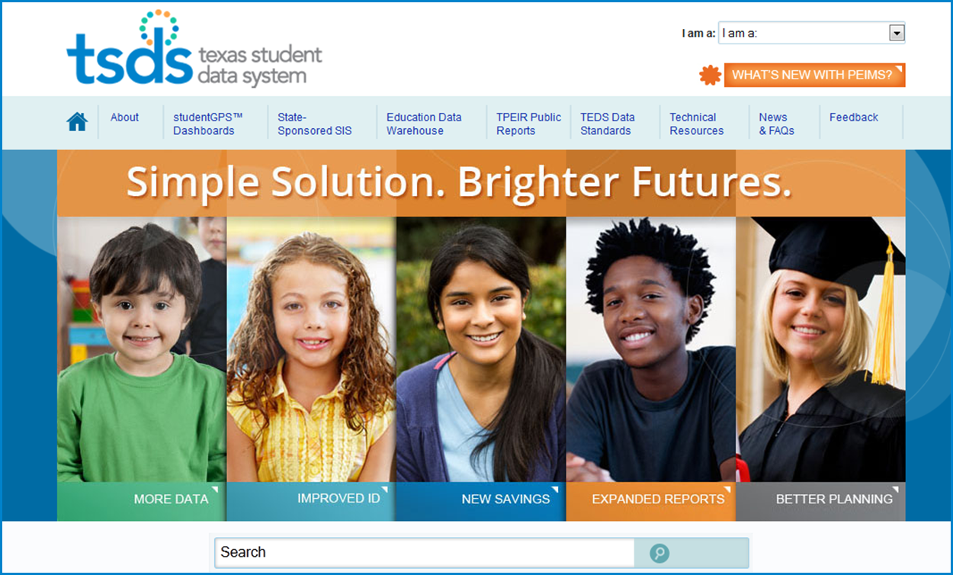
Questions?
For more information visit: www.TexasStudentDataSystem.org
Email questions to: TSDS_training@tea.Texas.gov

